Slide 1
ScavengerHunt
By Javier Salas, Jose Fernandes, Steven Fletcher

Slide 2
Target Audience
This app is meant for young, active people who are willing to go out and explore their surroundings
Ie: High Schoolers, College Students, and other Young Adults
Meant for competitive friends to try and show off against each other, while also exercising

Slide 3
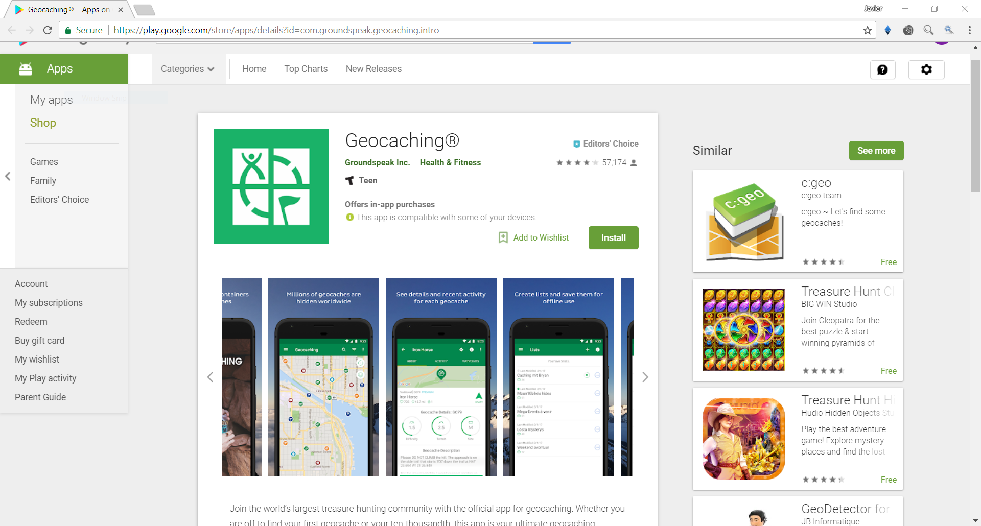
Background – What’s already there?
Other apps already accomplish similar tasks
Geocaching already has a fairly large community of users contributing to finding and placing landmarks/locations for others to find/place.
https://play.google.com/store/apps/details?id=com.groundspeak.geocaching.intro

Slide 4
What makes is stand out?
Localized in Tallahassee (for now)

Slide 5

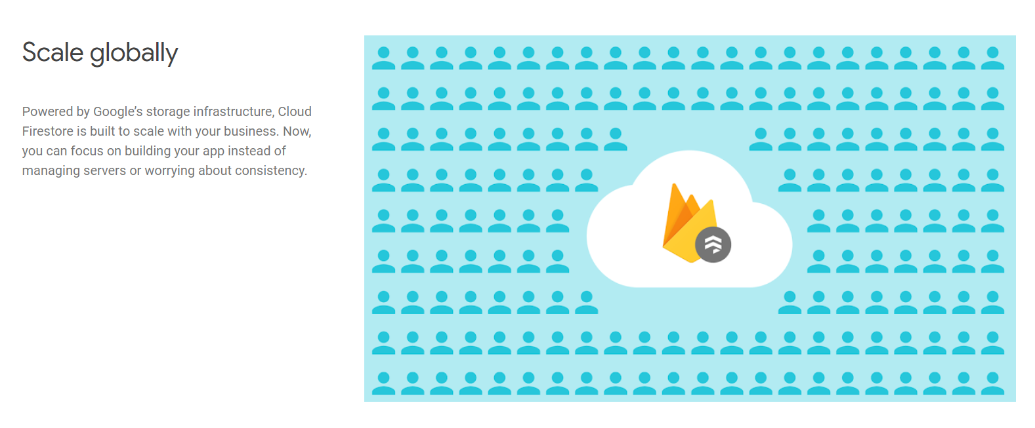
Being competitive – backend over frontend
Scalability is the name of the game when it comes to community drive platforms.
Being able to handle a large influx of users takes the load off of us as developers to be more UI focused
Firebase also has other great features that allow us to not worry about features like security, server upkeep, server management
https://firebase.google.com/products/firestore/

Slide 6
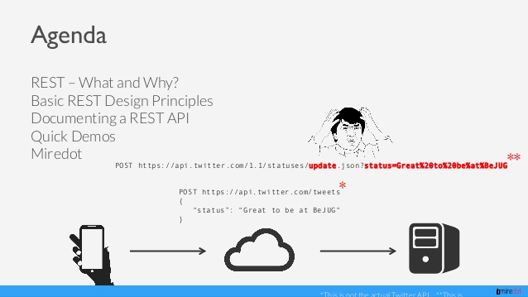
Time-consuming designs : RESTful
https://www.slideshare.net/miredot/restful-api-design-and-documentation-an-introduction

Slide 7

Databases – who needs them?
Databases are great if you have time to invest in building tables, relations, queries – but as android developer we don’t have time for that!

Slide 8
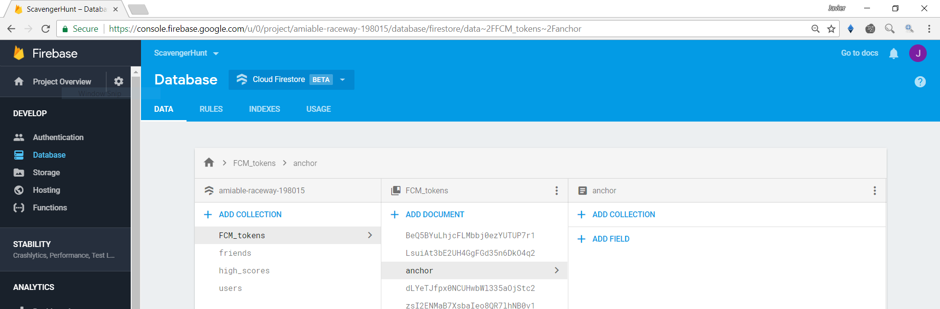
Solution : Firestore 🔥

Slide 9
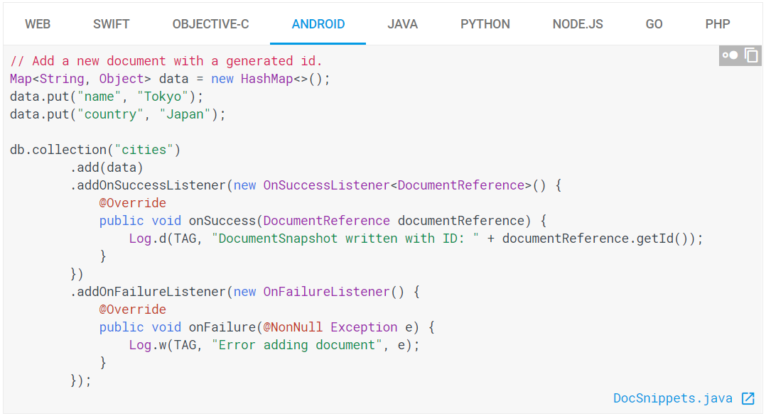
Problem : complex queries

Slide 10
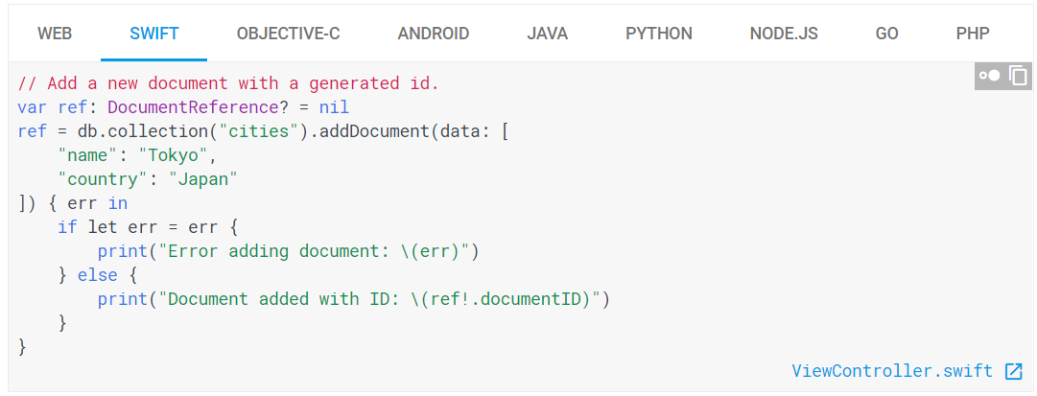
Problem 2 : IOS Support?

Slide 11
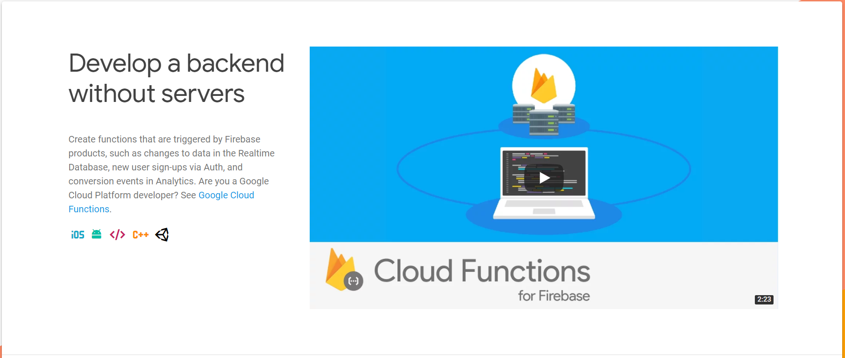
Solution : Firebase functions!
https://firebase.google.com/products/functions/

Slide 12
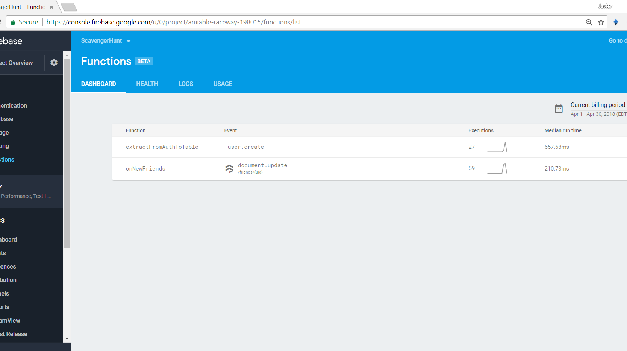
Functions in action

Slide 13
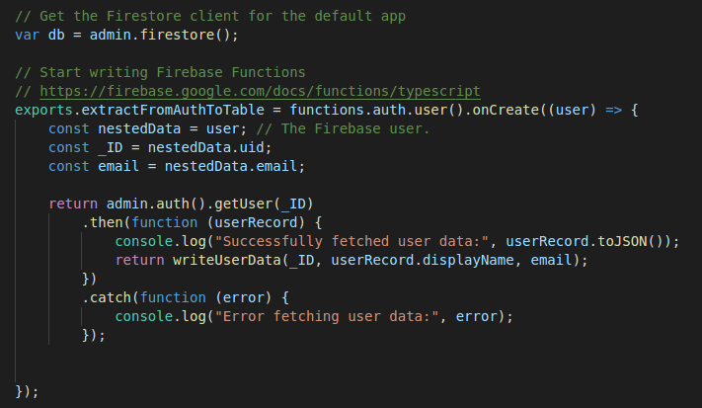
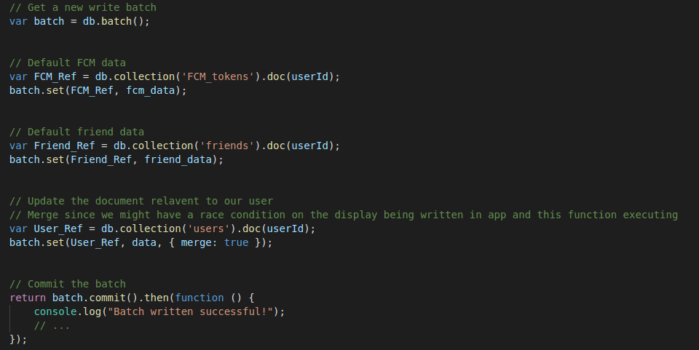
Firebase janky solutions – 1

Slide 14
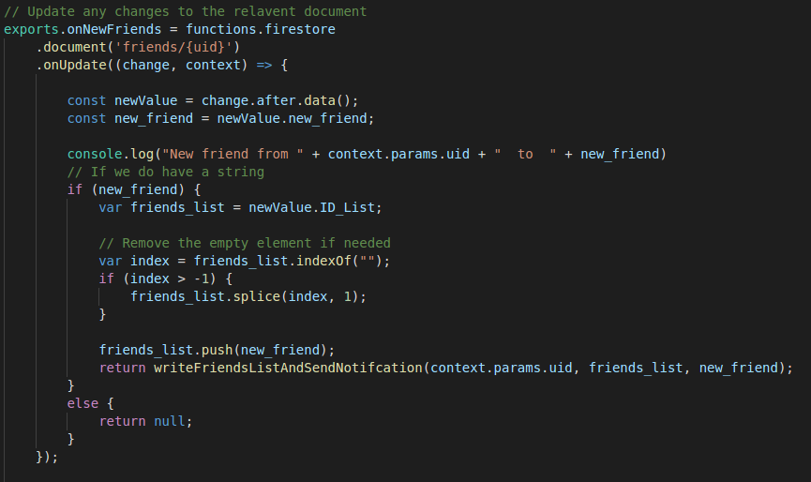
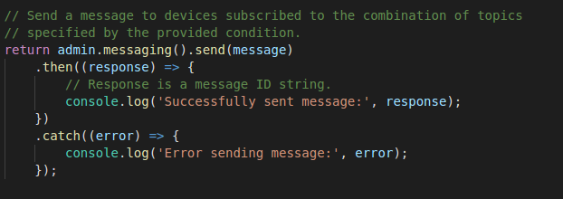
Firebase janky solutions - 2

Slide 15
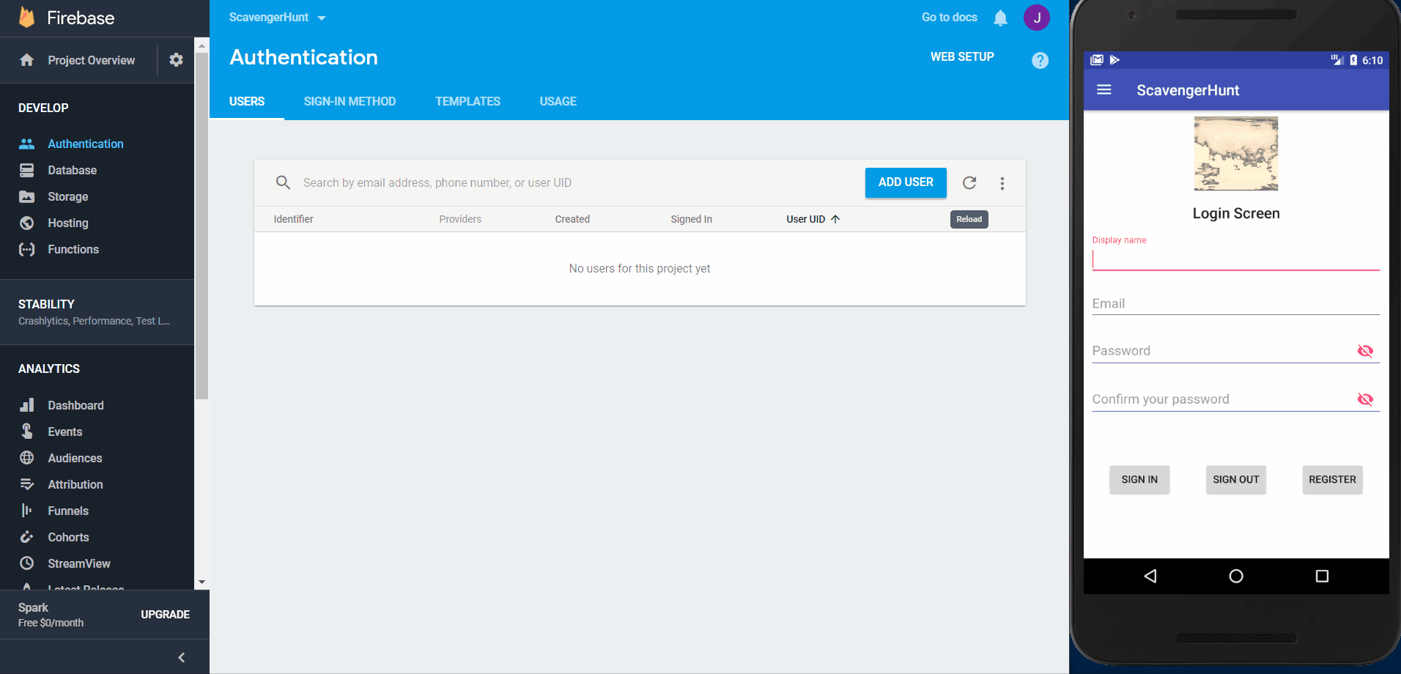
Demo : Firebase Functions

Slide 16
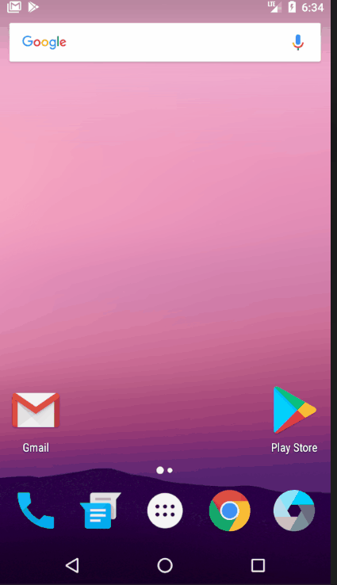
Demo : Firebase Functions
A very crude version of our notification system that for friends list

Slide 17

Leaderboards
Implemented a system for pushing player scores to the Google Play Games leaderboard
Encountered a LOT of problems

Slide 18
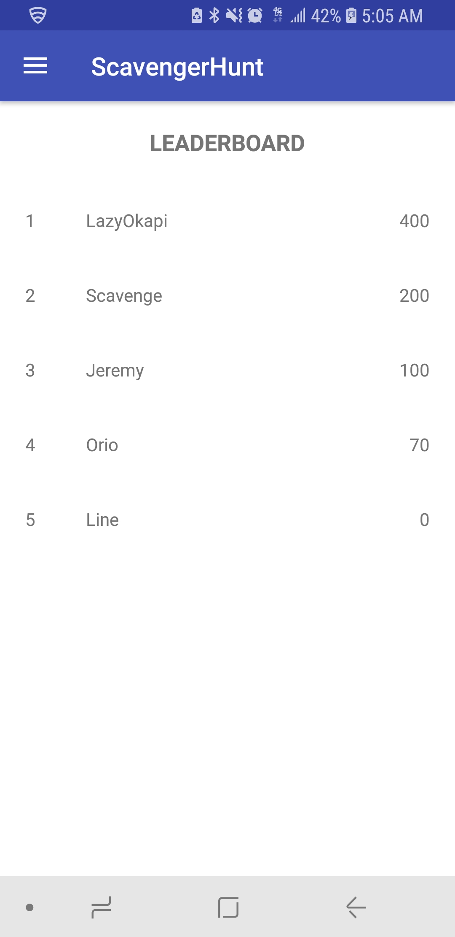
Leaderboards
We couldn’t find out how to do that so we
implemented our own version in Firebase
Implemented it as a list that updates if you have a
higher score than anyone on the list.

Slide 19

“We’ll Get That Done In Project 3” – The Road Ahead
General prettying up
Improved leaderboards
Improved messaging and friends mechanics
Randomized pins drawn from the GooglePlaces API
Easter Eggs (Probably)

